Slide 1


“Clean Energy for your off-grid Needs”

Slide 2
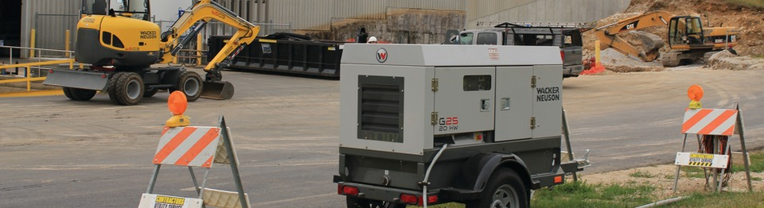
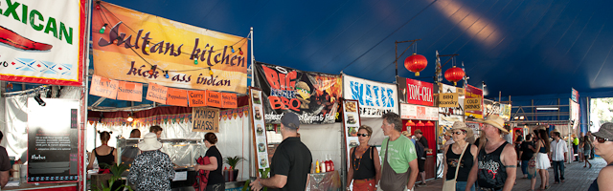
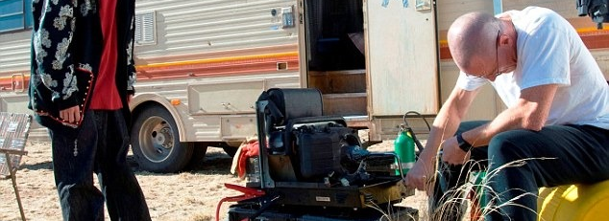
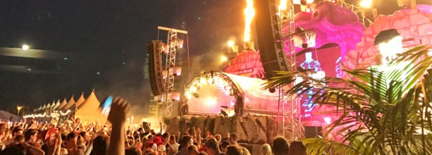
Problem # 1
Off grid Consumptions
Concert, Festivals, Construction Sites
Inefficient off-grid solutions
Use of fossil fuel for remote activities
Noise and environmental Concerns
8000 festivals in Germany alone emitting 5 million ton CO2 per year.

Slide 3
Problem # 2
Wind Curtailment
Wind curtailment is the reduction in electricity generation below the full capacity of wind farm. It represents a significant loss in economic and energy efficiency.
Wind energy is Highly Variable and Unpredictable
Inefficient Grid capacity
“Full potential of wind energy is not being utilized”

Slide 4
Problem # 2
Increasing penetration of renewable energy leads to increased curtailment due to insufficient grid capacity.

Slide 5









Business Model / Our Service

Slide 6
Case Study – Wind Curtailment
Cluster | Curtailment duration in 2017 (hours) | Max power of each turbine (MWh) | Max curtailed energy (MWh)
1 | 383 | 2.5 | 16,469
2 | 3,356 | 2.3 | 92,626
3 | 2,462 | 2.3 | 169,895
4 | 2,856 | 3 | 197,111

Slide 7
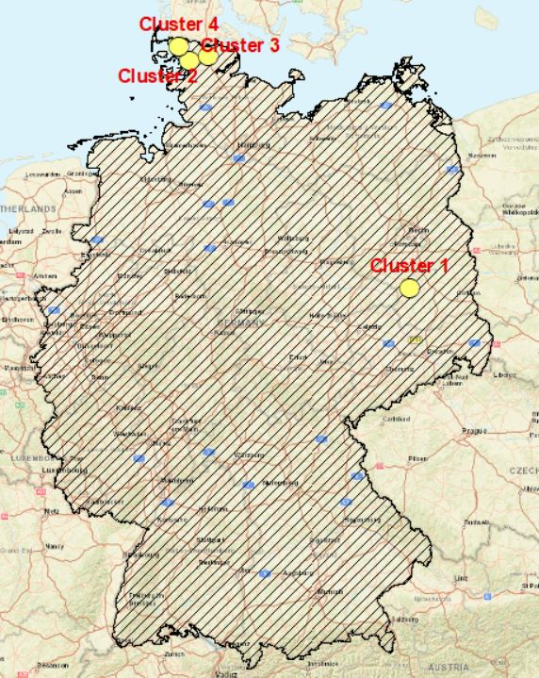
GIS Map
Figure 3: GIS Map of interesting wind farms

Slide 8
Calculating Curtailment Profile
Total duration of curtailment = 2831 hours (32 %)
Total energy curtailed = 134 GWh

Slide 9
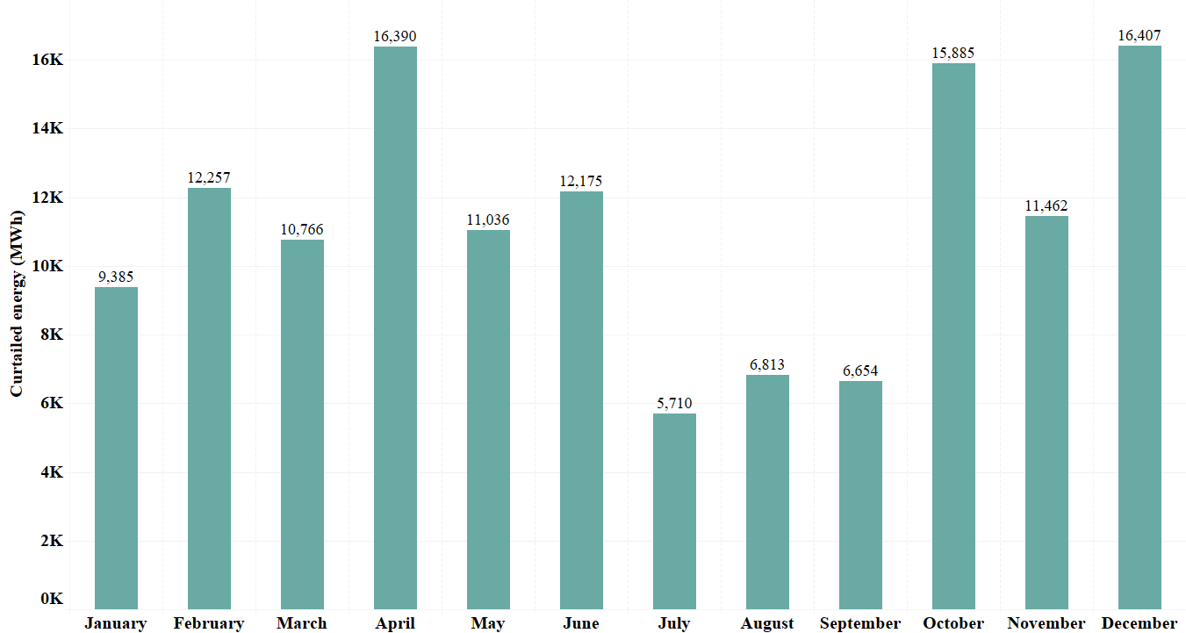
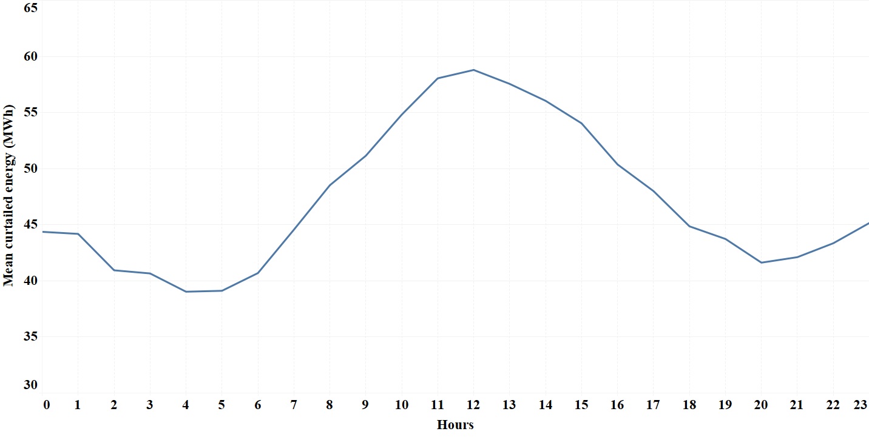
Calculating Curtailment Profile
Monthly curtailment profile Daily Average Curtailment Profile
Figure 6: Monthly Curtailment Profile
Figure 7: Daily Average Curtailment Profile

Slide 10
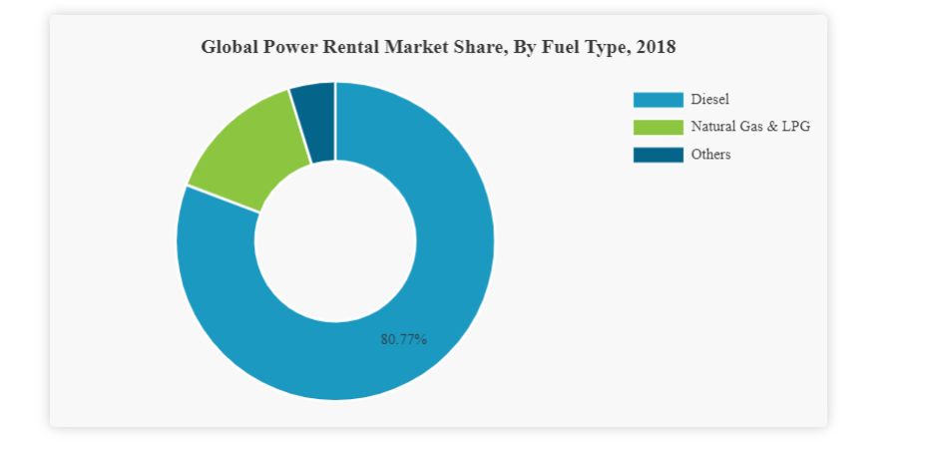
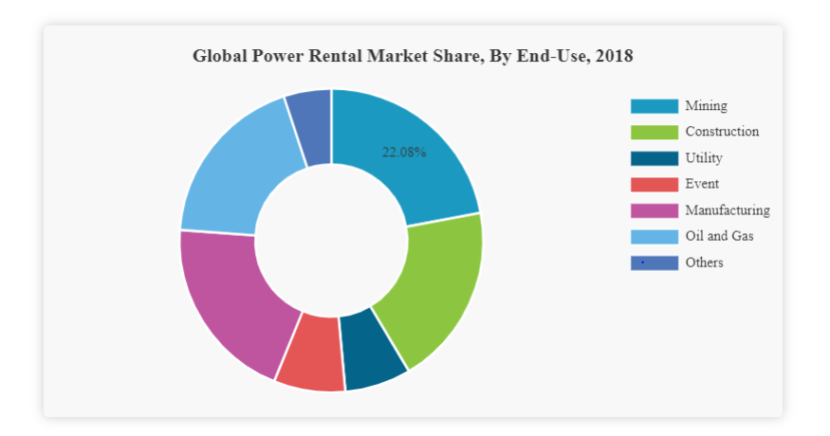
Marketing Strategy – customer segment

Slide 11
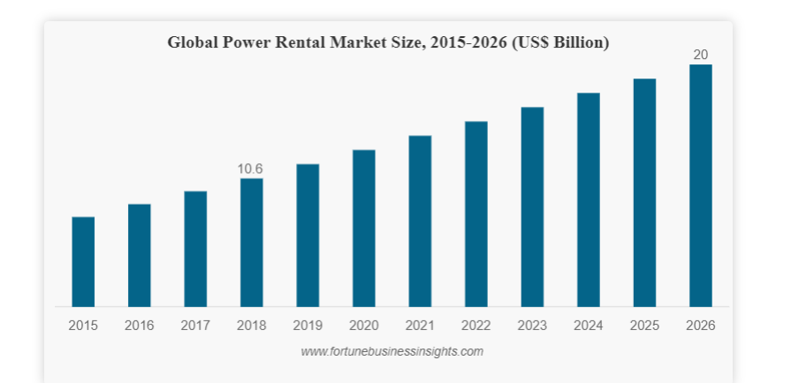
Marketing Strategy – customer segment

Slide 12
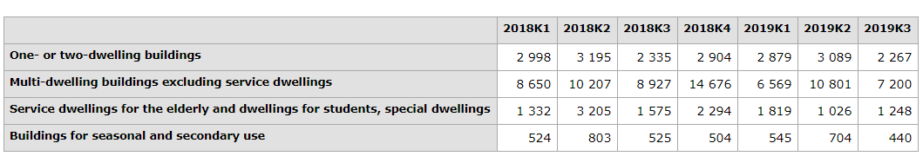
Marketing Strategy – customer segment
Building permits for new construction, dwellings by type of building in Stockholm Lan

Slide 13
Construction Market Insights
Focused more on health and safety standards more than sustainability
Drilling and mining applications need air ventilation when using diesel
70 % construction in summers, 30 % in winter (Stockholm)

Slide 14
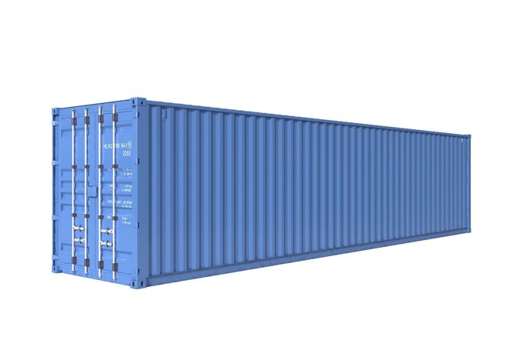
Marketing strategy – Pricing Analysis
Three Storage system
Size = 1.5 MWh
Dimensions = 40 ft Shipping container
Project life = 10 years
LCOS = 0.25 $/kWh

Slide 15
Marketing strategy – Pricing strategy
Value base pricing strategy
Environmental and health and safety value
Our price = Competing price to diesel generator + premium
Generator QAS150
Power (kW) | 120
CO2 emission (kg/liter)[40] | 2.6
Load rating | 100 % | 75%
Operating hours | 12.5 | 16.67
Total energy produced (kWh) | 1500 | 1500
Fuel consumption (liters/hour) | 32 | 27.7
Fuel price ($/liter) | 1.3899 | 1.3899
Total fuel price ($) | 555.96 | 641.80
Rent per day ($) | 173.8 | 173.8
Total price ($) | 729.76 | 815.60
Total CO2 emissions (kg) | 1040 | 1200
Price per unit ($/kWh) | 0.4865 | 0.5437

Slide 16
Market strategy – customer outreach
First clients in Mining and Construction industry
Participation in business creation programs ( e.g., Sidewalk )
Contacts with key industry professionals, investors, contractors
After product/service ready market by energy competitions and networks

Slide 17
Market strategy – customer outreach
First clients in Mining and Construction industry
Participation in business creation programs ( e.g., Sidewalk )
Contacts with key industry professionals, investors, contractors
After product/service ready market by energy competitions and networks

Slide 18
Competitors Analysis

Slide 19
Competitors Analysis

Slide 20
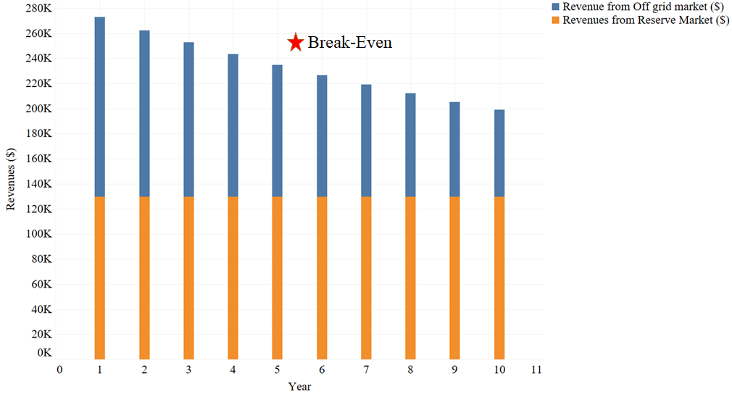
Revenue Streams
Two revenue streams
Frequency reserve:
Capacity price = 30$/kW
4 Winter Months
Cycle utilization = 50%
Off-grid market
Price = 0.6$/kWh
Cycle utilization = 50%
3. Capital
Cost of battery = 1.3 mil.$

Slide 21
THANK YOU

